Slide 1
The ART of Costume Design

Slide 2
CLOTHING TERMINOLOGY
Words to Define and Identify Wardrobe and Costume Elements

Slide 3
Clothing Terminology Categories
Fabrics
Fabric manipulation
Color
Sewing terms
Patternmaking terms
Describing length (skirts & dresses)
Parts of garments
Types of basic garments
Styles of garments(contemporary and historical)
Clothing details
Functional uses of garments
Traditional garments
Fashions

Slide 4
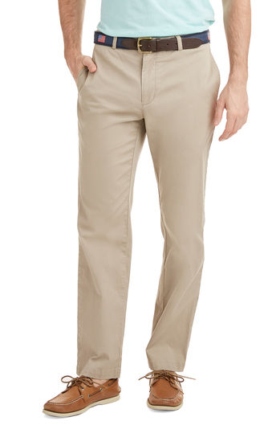
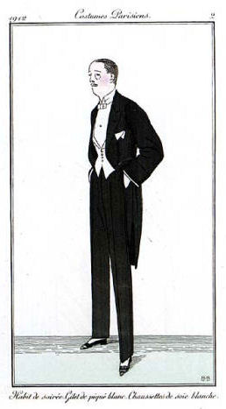
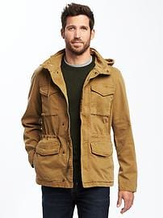
Garments - Men
Shirt Pants Suit Coat/Outerwear

Slide 5
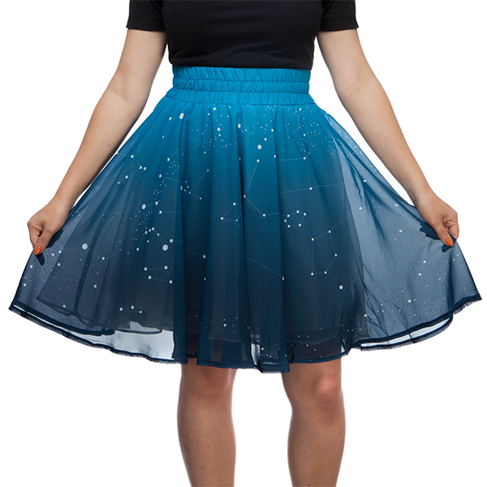
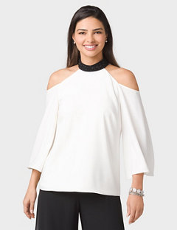
Garments - Women
Dress Skirt Shirt/Blouse Swimwear

Slide 6
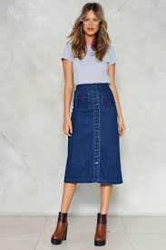
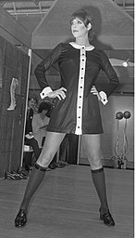
Skirt / Dress length
Full / Floor Length Mid Length Mini

Slide 7
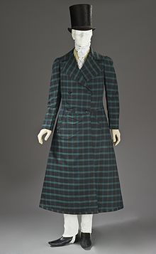
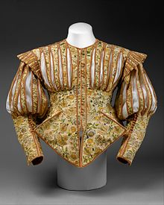
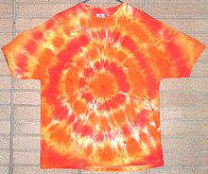
Historical Clothing
Corset Frock Coat Doublet T-Shirt

Slide 8
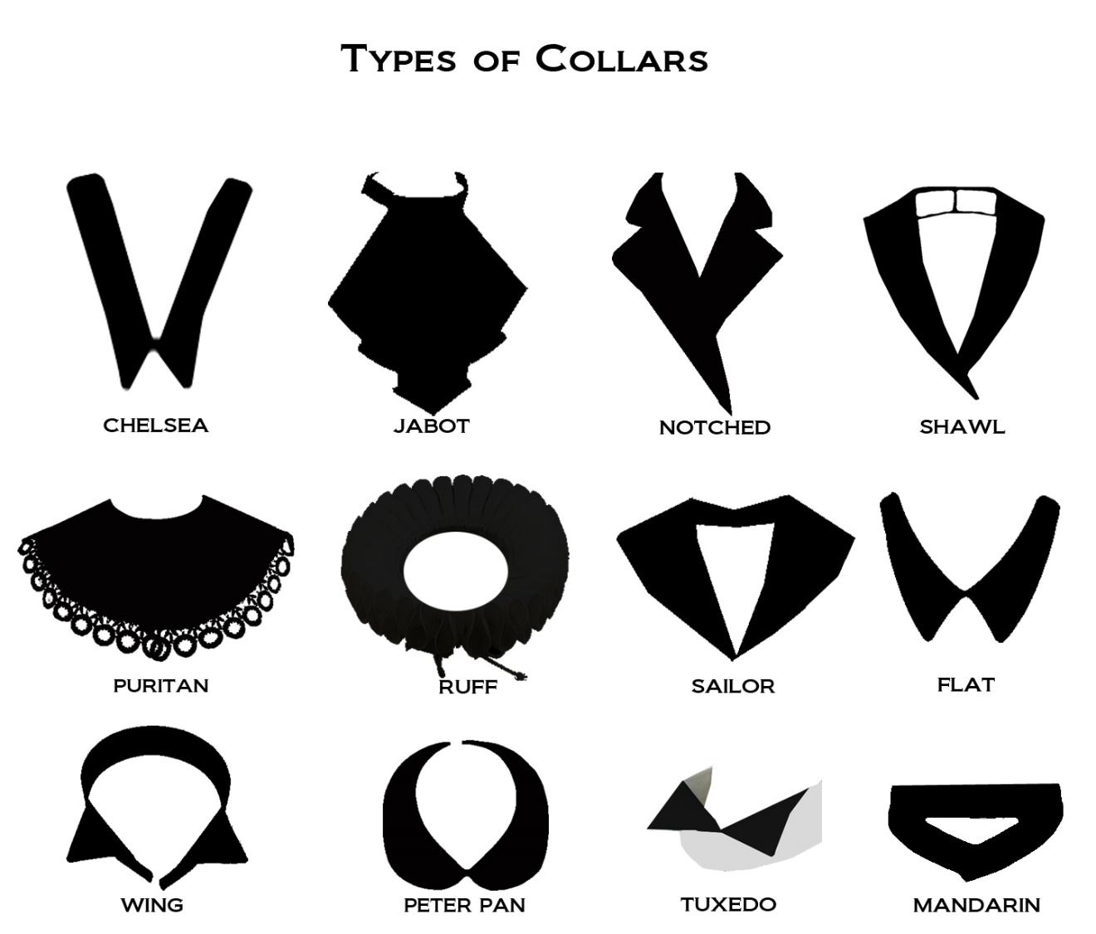
Parts Of Garments

Slide 9
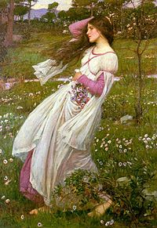
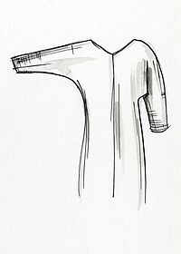
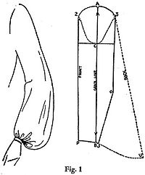
Styles of Garments -Sleeves
Juliet Paned / Panel Batwing / Dolman Bishop

Slide 10
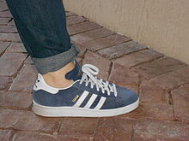
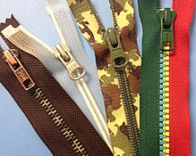
Clothing Details
Pocket Cuff Zipper

Slide 11
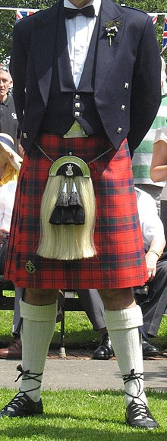
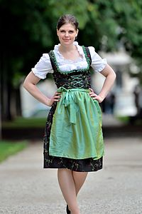
Traditional Garments
Cheongsam Kilt Dirndl

Slide 12
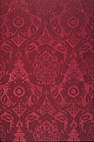
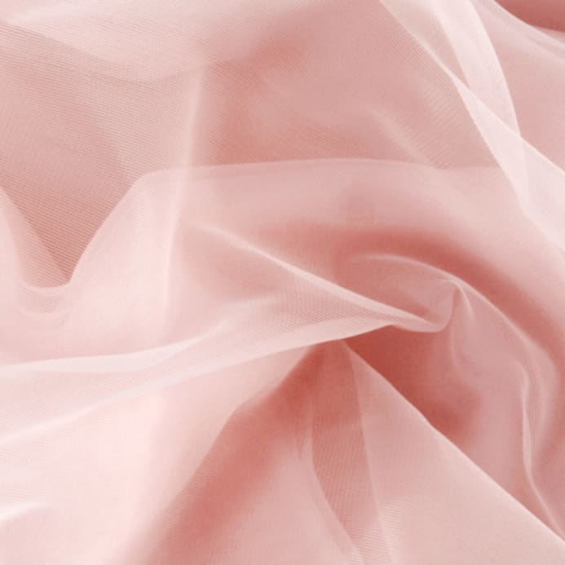
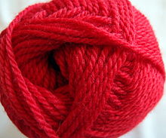
Fabrics
Denim
Embossed Velvet
Chiffon
Wool
Silk

Slide 13
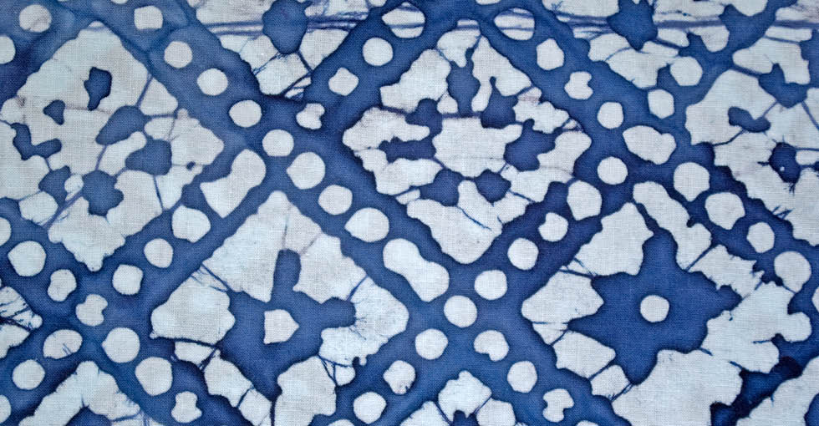
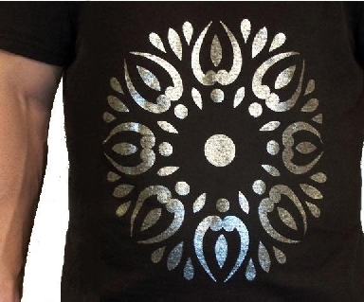
Fabric Treatments
Ikat Batik Transfer

Slide 14
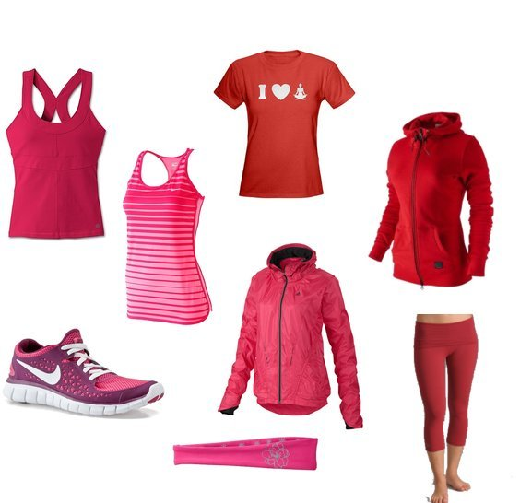
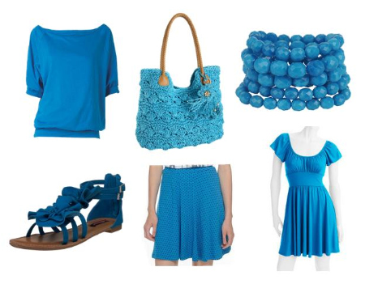
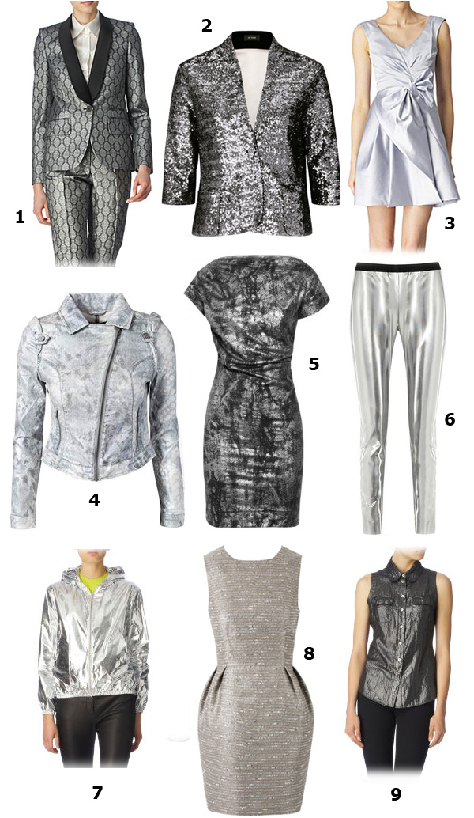
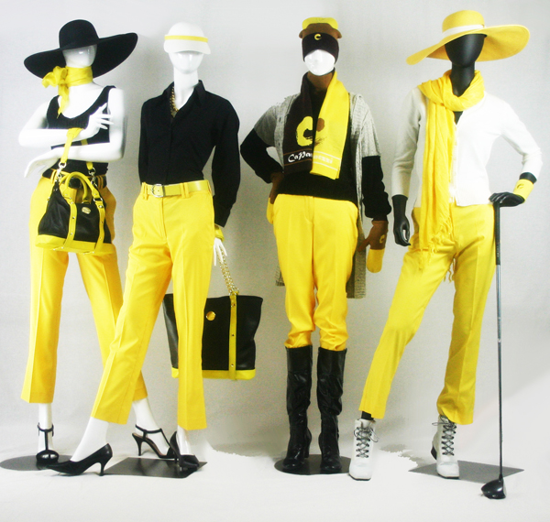
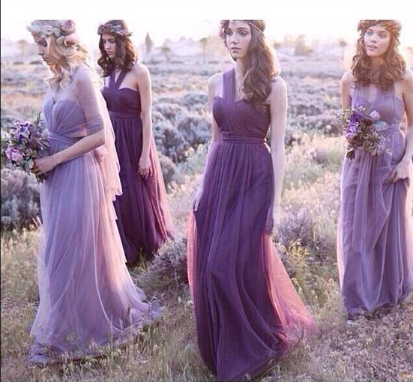
Color

Slide 15
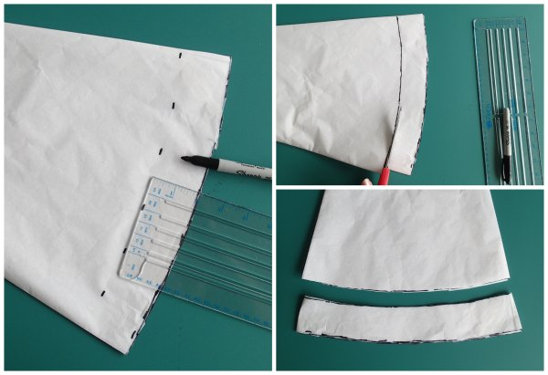
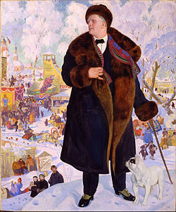
Sewing Terms
Cut Hem Line

Slide 16
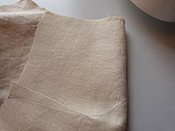
Pattern Making Terms
Dart

Slide 17
Austin Opera is renting the costumes for our production of La traviata from Utah Opera. Before the costumes arrive, Austin Opera’s Wardrobe Supervisor will get stock photos of each of the costumes. A Costume Inventory will also be shared, listing every piece of every costume that is included in the rental. Depending on the production, items like shoes and jewelry may or may not be included. If they are not, then our local wardrobe staff will either pull items from our warehouse or go out and purchase items to supplement what is coming with the rental.
CASE STUDY:

Slide 18
How would you describe Violetta’s ACT I party costume?

Slide 19
How would you describe Violetta’s ACT I party costume?
Possible answers:
V-neck
Off the shoulder
Short-sleeved
Full length
Fitted bodice
Lace
Red

Slide 20
How would you describe Violetta’s ACT I party costume?
Here is the information from the COSTUME INVENTORY about Violetta’s dress:
Red beaded gown
Tulle petticoat
Camelia
Diamond earrings & bracelet
Red fan
DID YOU NOTICE?
The dresses pictured here are different. Why do you think they used a different dress for the production pictured?

Slide 21
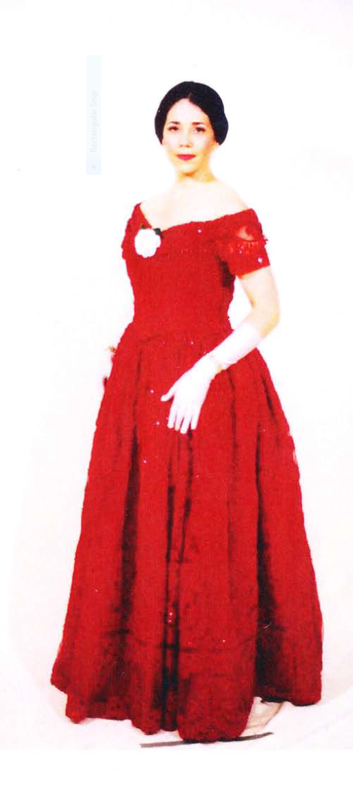
How is Violetta’s dress in ACT II the same? Different?

Slide 22
Label the parts of Alfredo’s costume.

Slide 23
Label the parts of Alfredo’s costume.
PANTS
SHIRT
VEST
TIE
SHOES

Slide 24
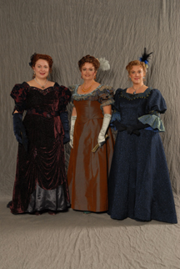
Here are some examples of Chorus costumes for La traviata. Based on the costumes you see, what do you think is happening in this scene?

