Slide 1
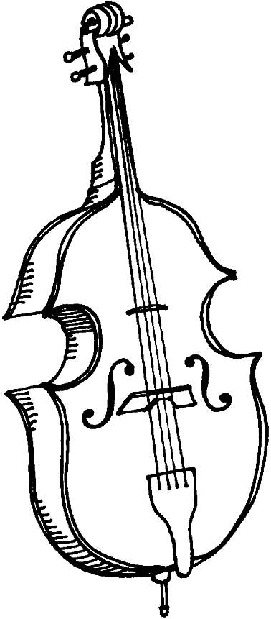
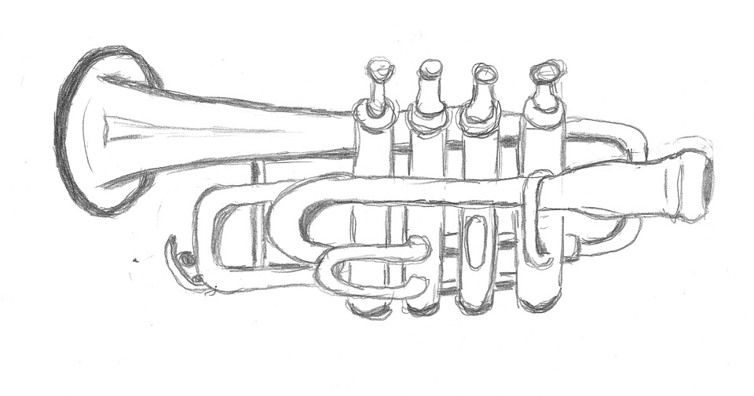
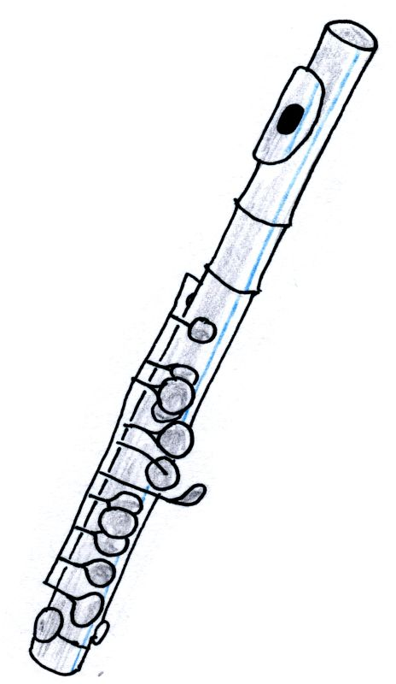
Still Life:
Musical Instruments

Slide 2
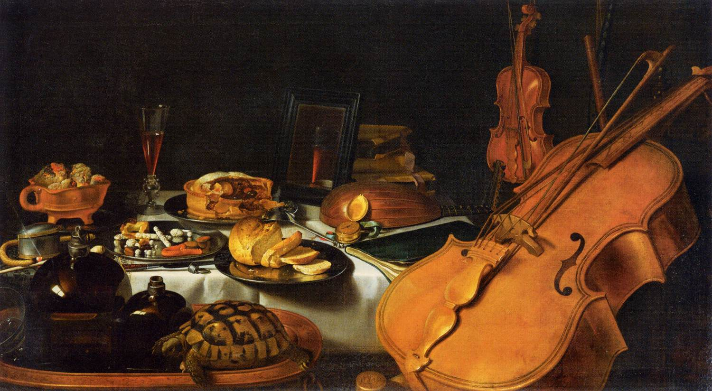
Pieter Claesz (1597-1660), Still Life with Musical Instruments, 1623. Oil on canvas. Louvre Museum. This Baroque painting was created during the Dutch Golden Age.

Slide 3
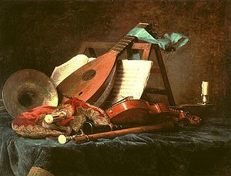
Anne Vallayer-Coster (1744-1818), Attributes of Music, 1770. Oil on canvas. Louvre Museum.
Vallayer-Coster was a French artist; Marie Antoinette was one of her main patrons. This still life is in the Rococo style.

Slide 4
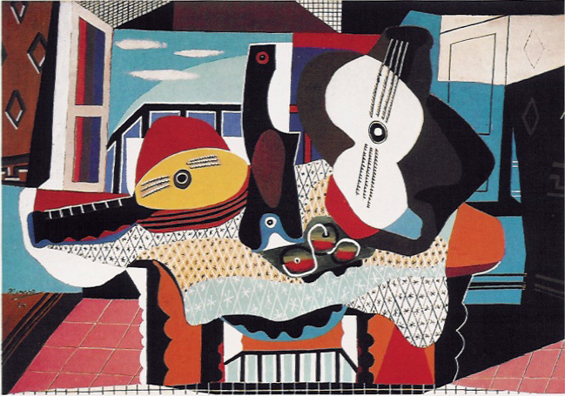
Pablo Picasso (1881-1973), Mandolin and Guitar, 1924. Oil on canvas. Guggenheim Museum.
Originally from Spain, Picasso lived in France and developed the style of Cubism.

Slide 5
What is a Still Life?

Slide 6
What is a Still Life?
A Still Life is a painting or drawing of an arrangement of objects, typically including fruit and flowers and objects contrasting with these in texture, such as bowls and glassware.
Your still life will focus on musical instruments.

Slide 7
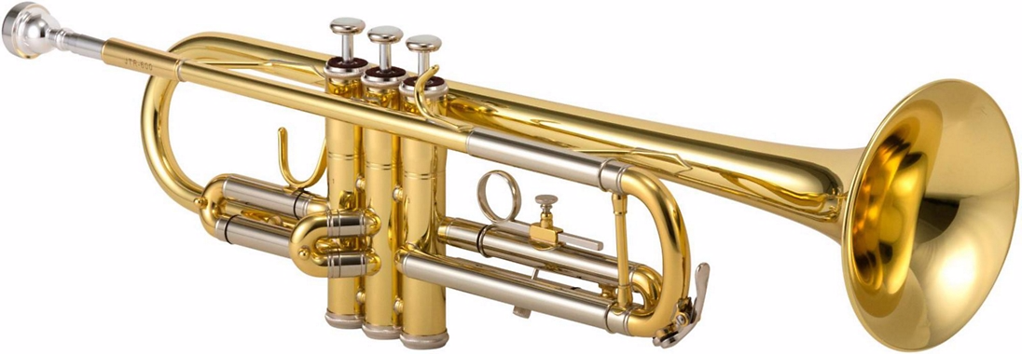
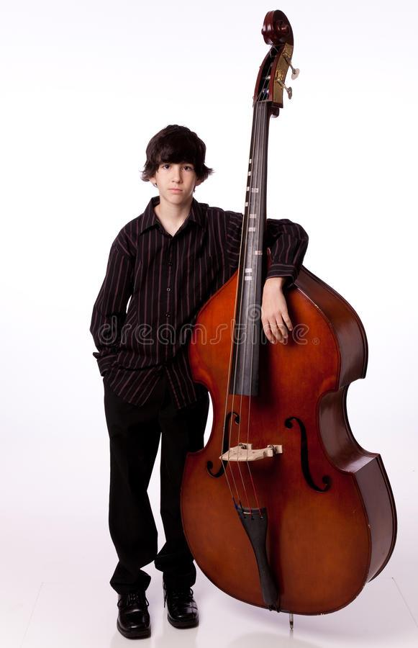
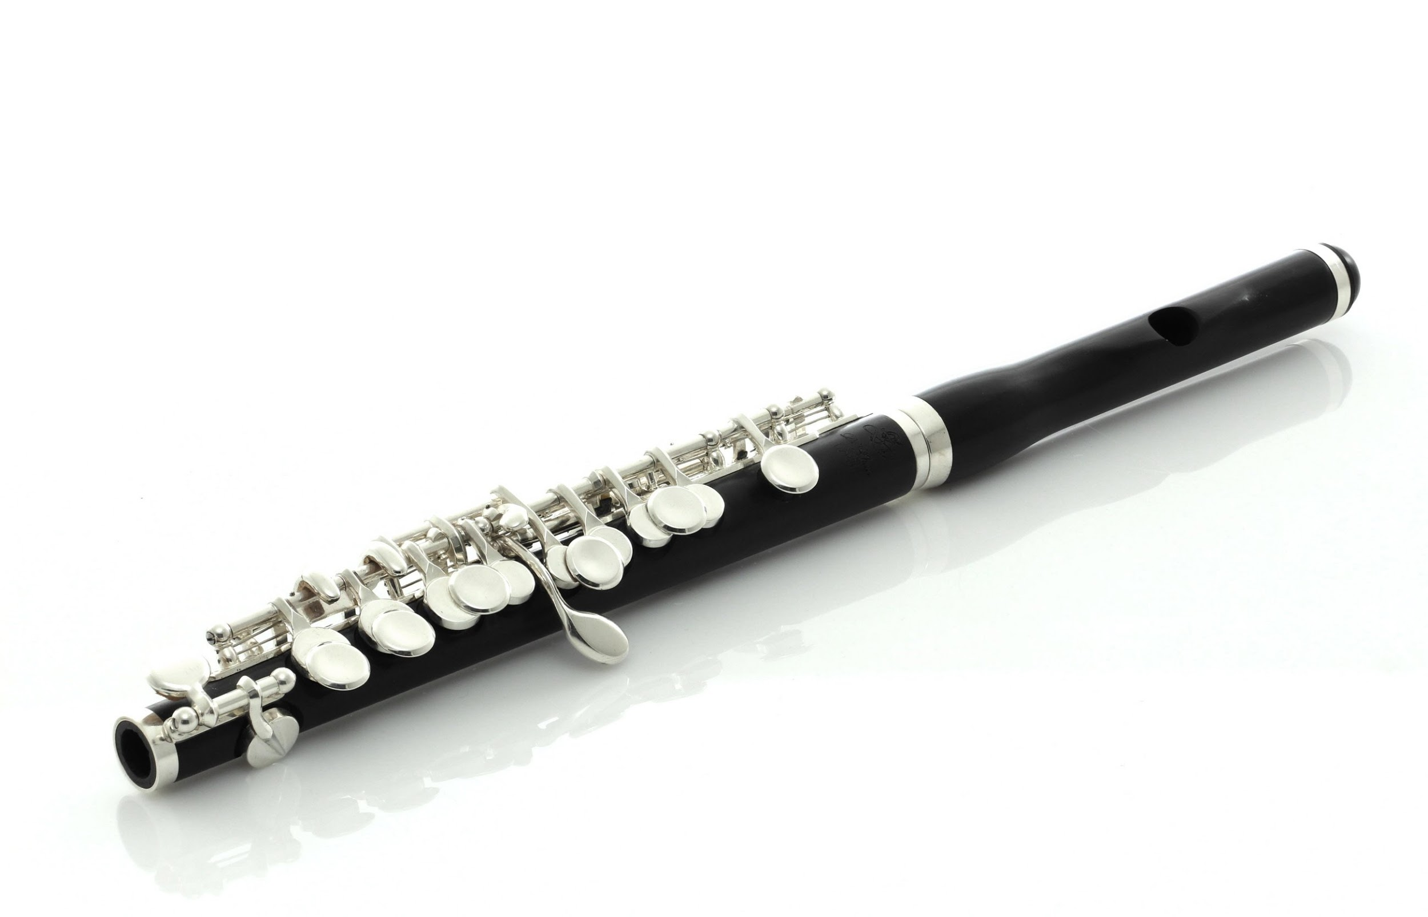
Instrument Families
What do we already know about these instruments?
What family does each of them belong to?
How do they produce sound?
Can you describe the sounds each of them makes?
How are they similar? Different?

Slide 8
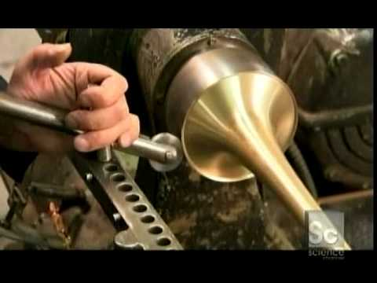
A little information
about trumpets...

Slide 9
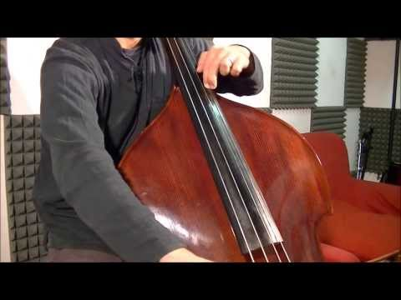
A double bass in action...

Slide 10
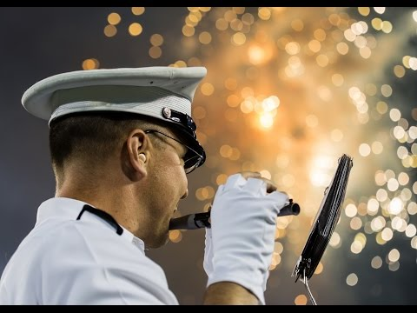
Piccolo player...

Slide 11
ELEMENTS OF ART & PRINCIPLES OF DESIGN
Before you get started on your still life, it’s a good idea to study your subject matter. Pay attention to the Elements of Art and Principles of Design as you create your artwork....
Elements of Art LINE SHAPE COLOR TEXTURE FORM SPACE VALUE | Principles of Design EMPHASIS REPETITION/PATTERN MOVEMENT/RHYTHM CONTRAST/VARIETY BALANCE PROPORTION UNITY

Slide 12
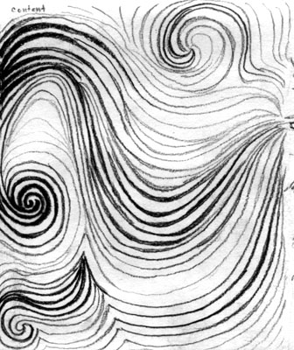
...especially LINE...

Slide 13
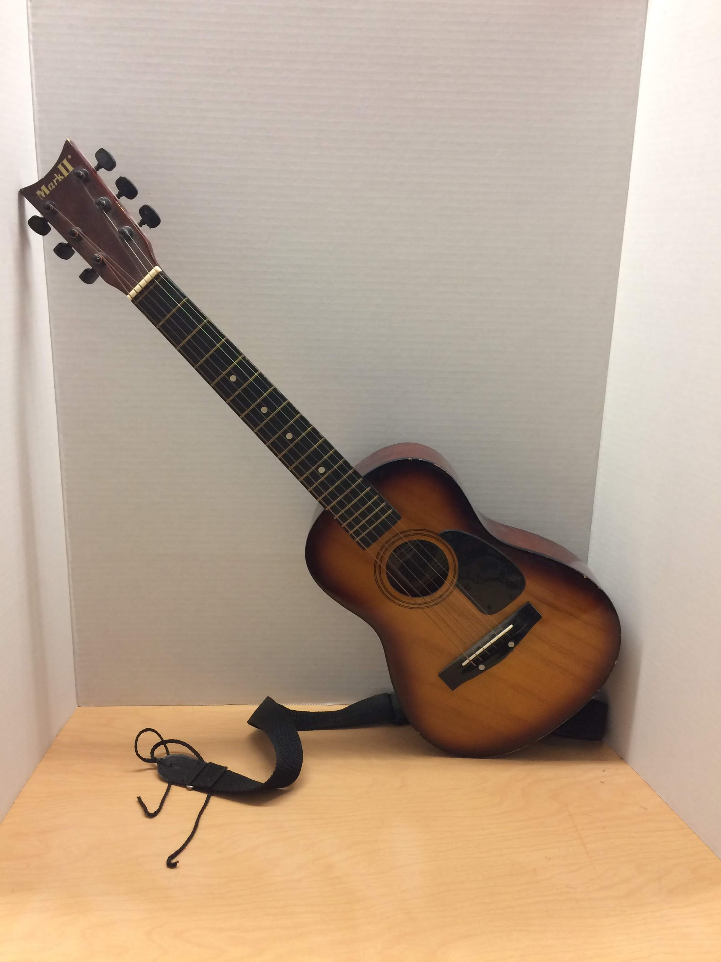
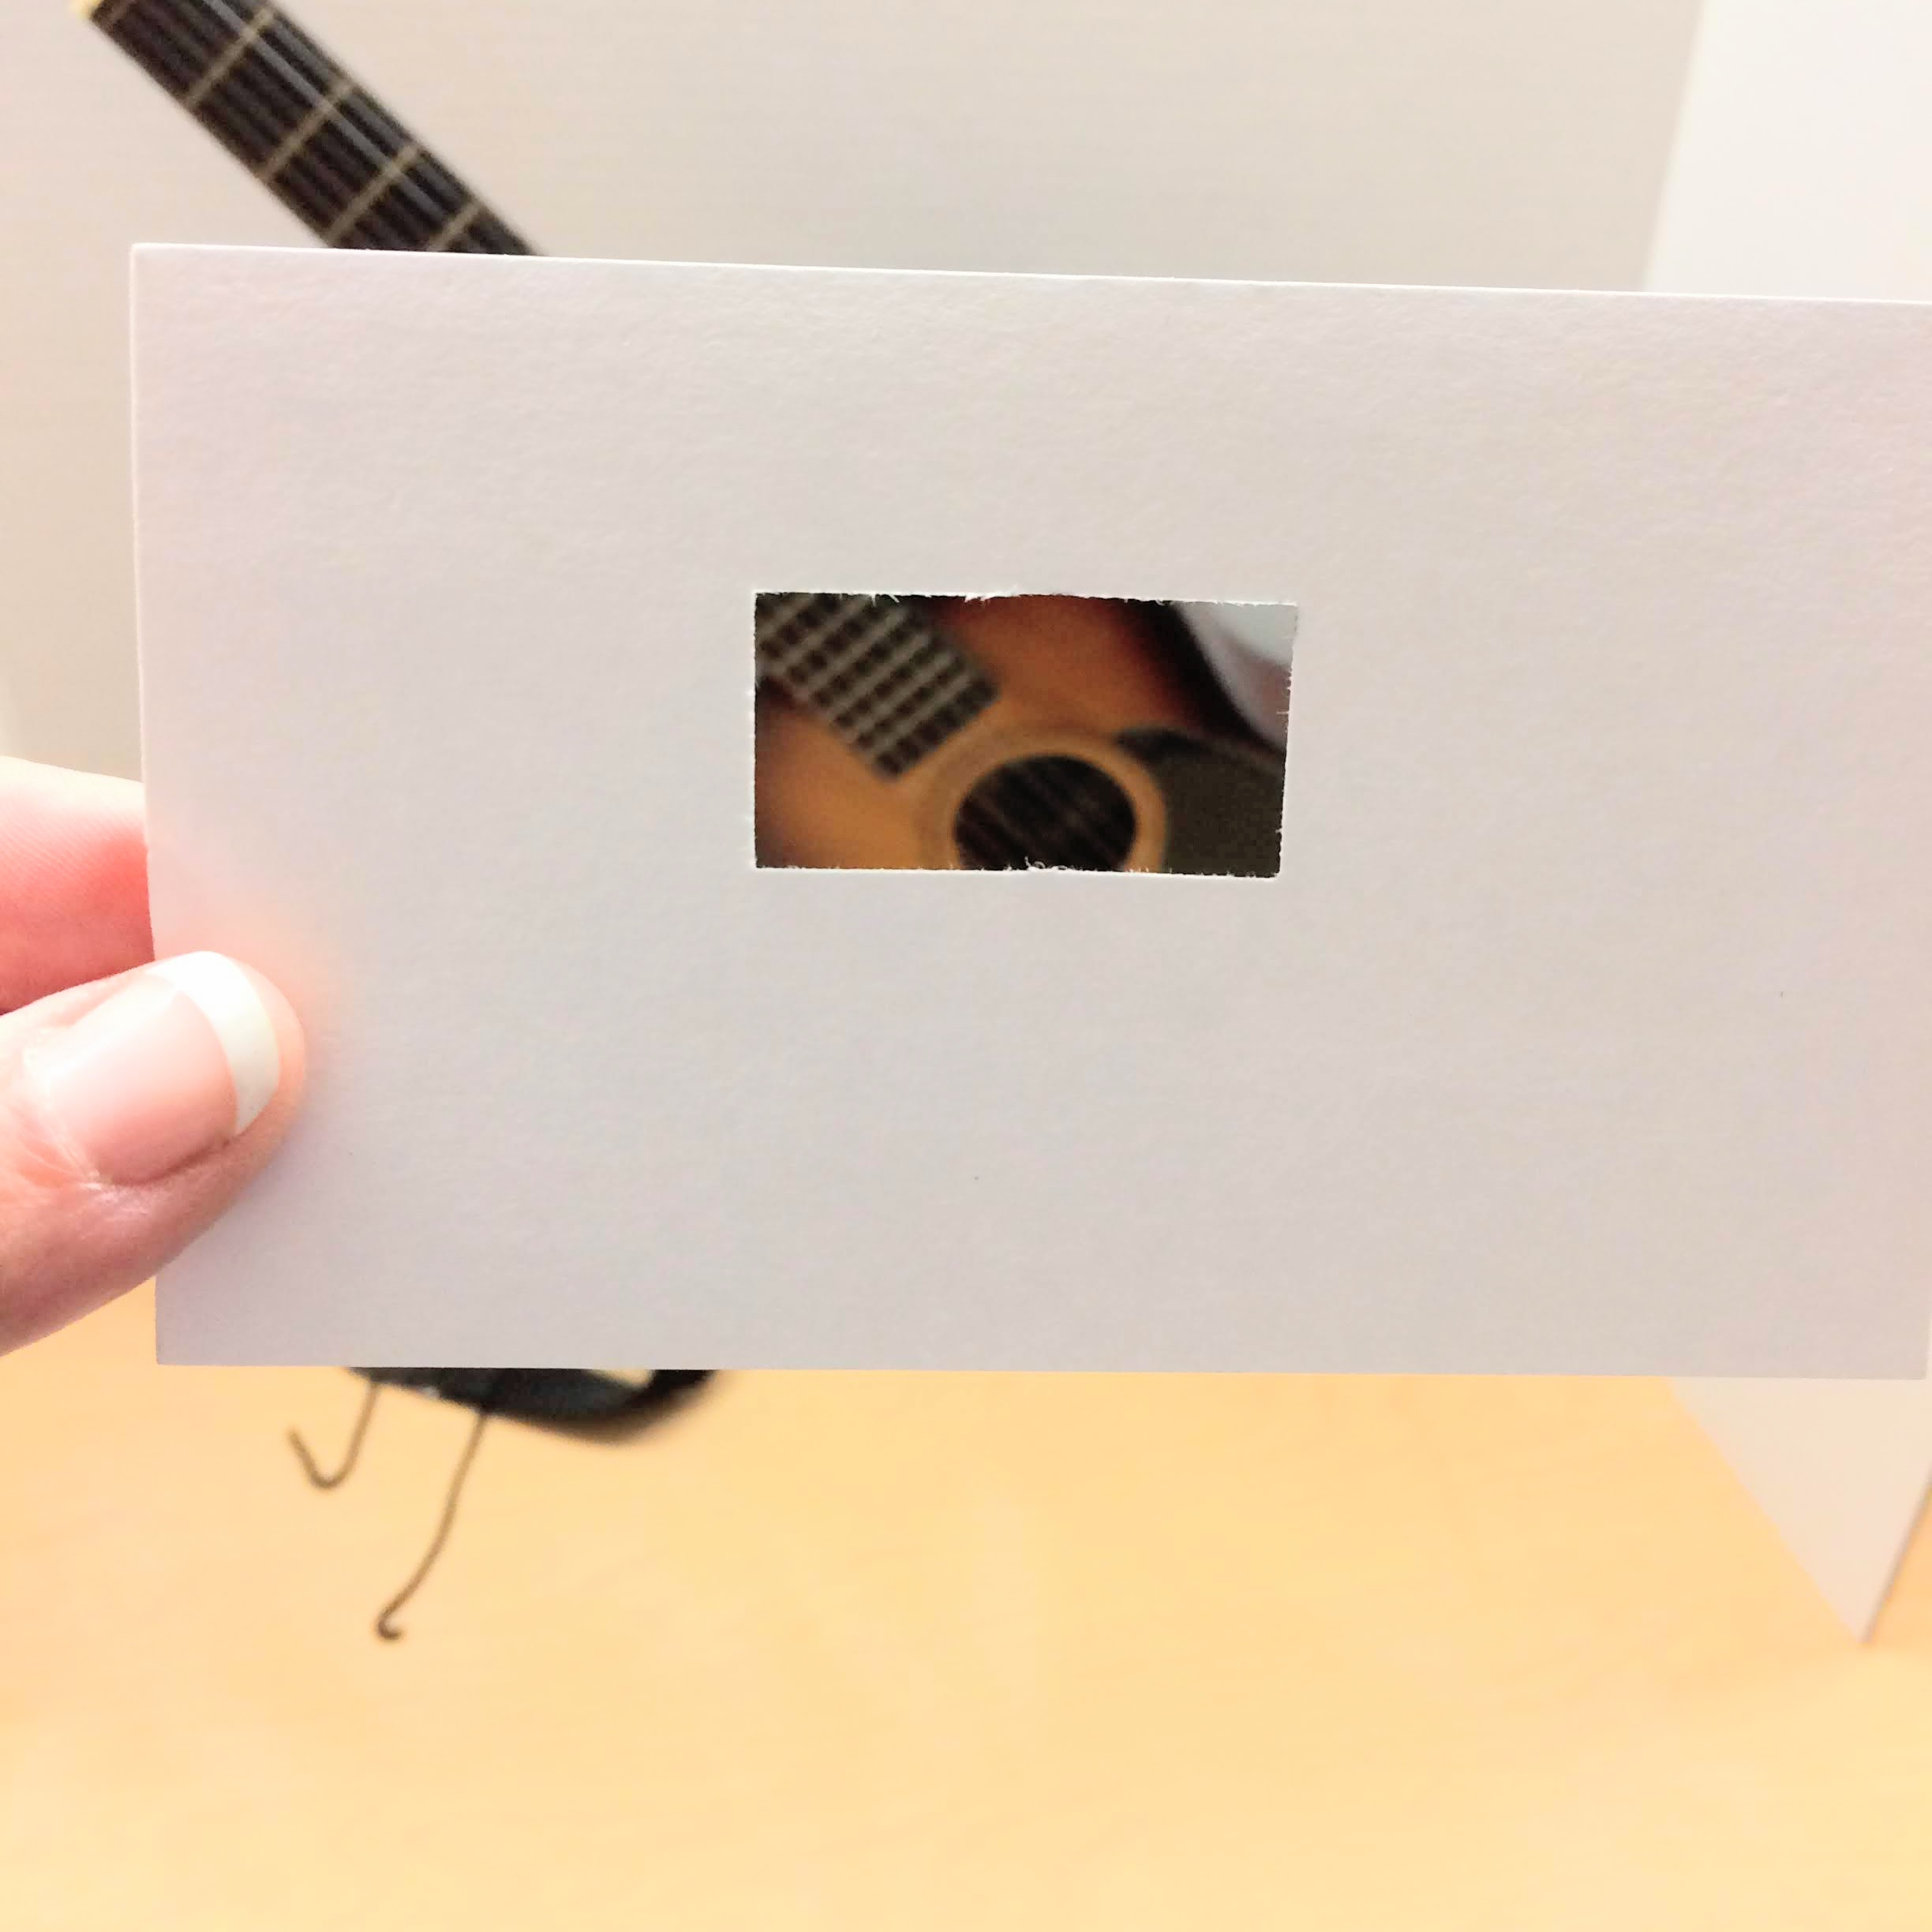
How do you create a Still Life?
Set up your objects. You can use a piece of fabric or paper to provide a backdrop.
Use a viewfinder to help you focus on which part of the still life you want to draw.

Slide 14
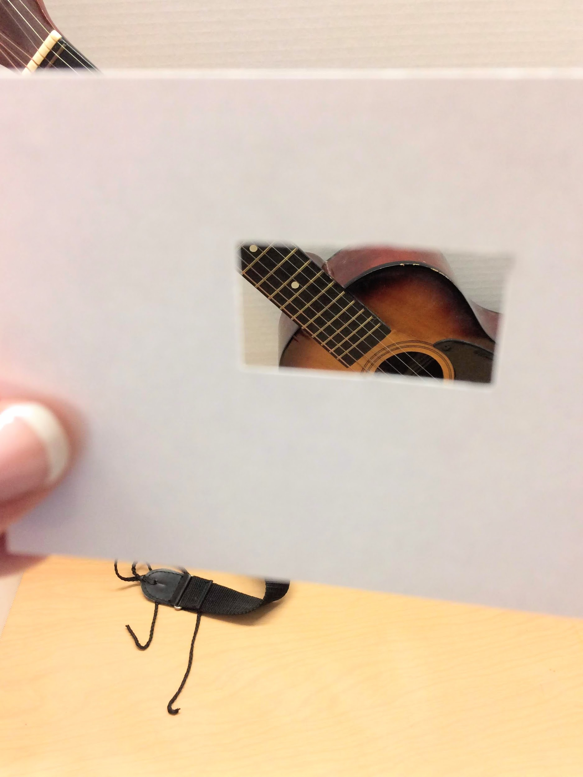
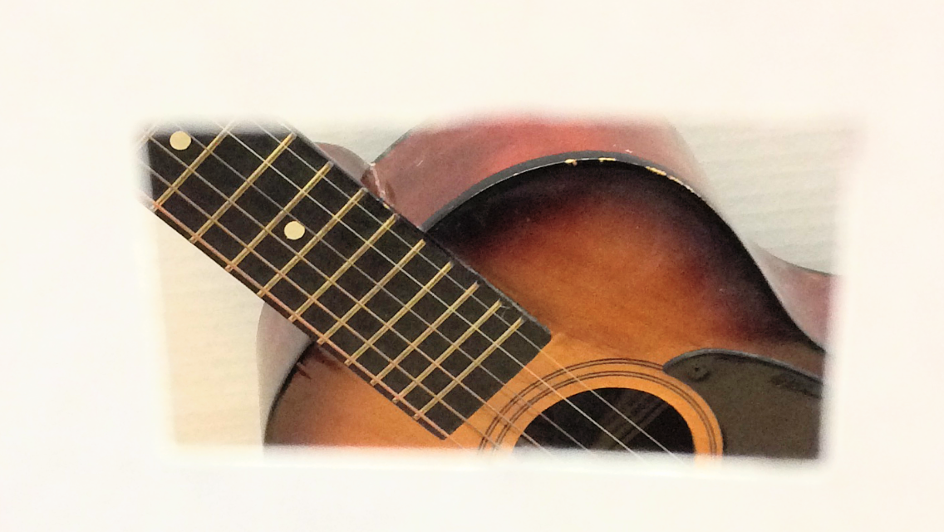
Once you have “cropped” your image, begin looking at the LINES you will need to draw. What do you see -- straight? Curvy? Be sure to use your keen observation skills!

Slide 15
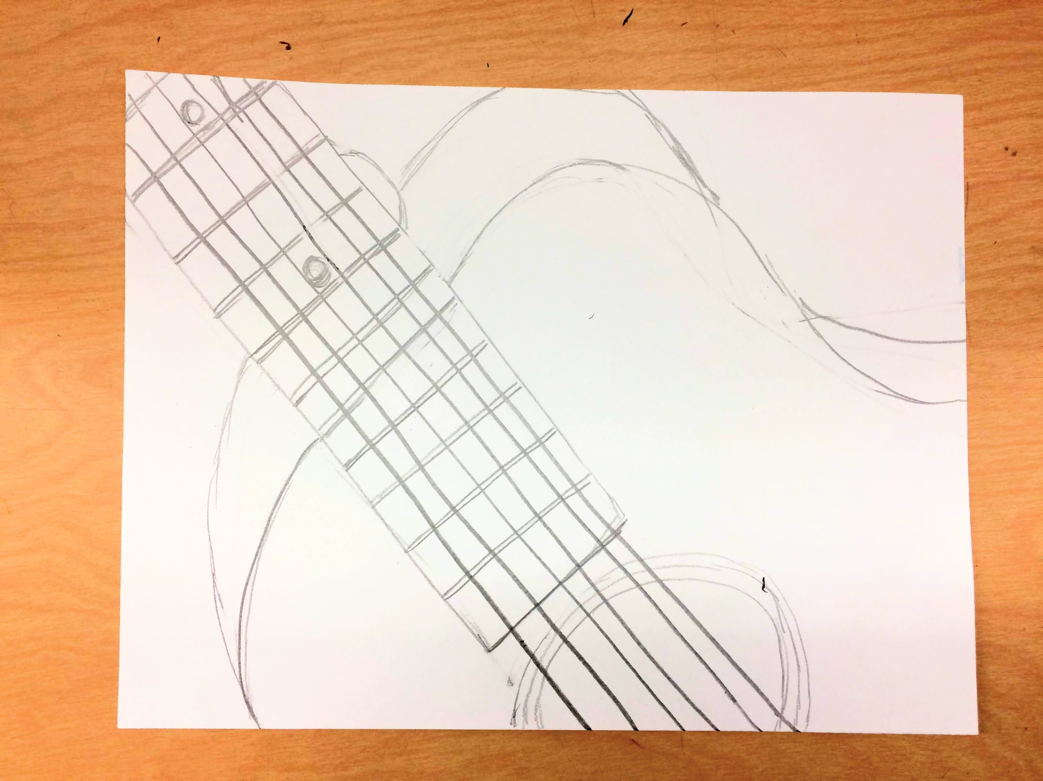
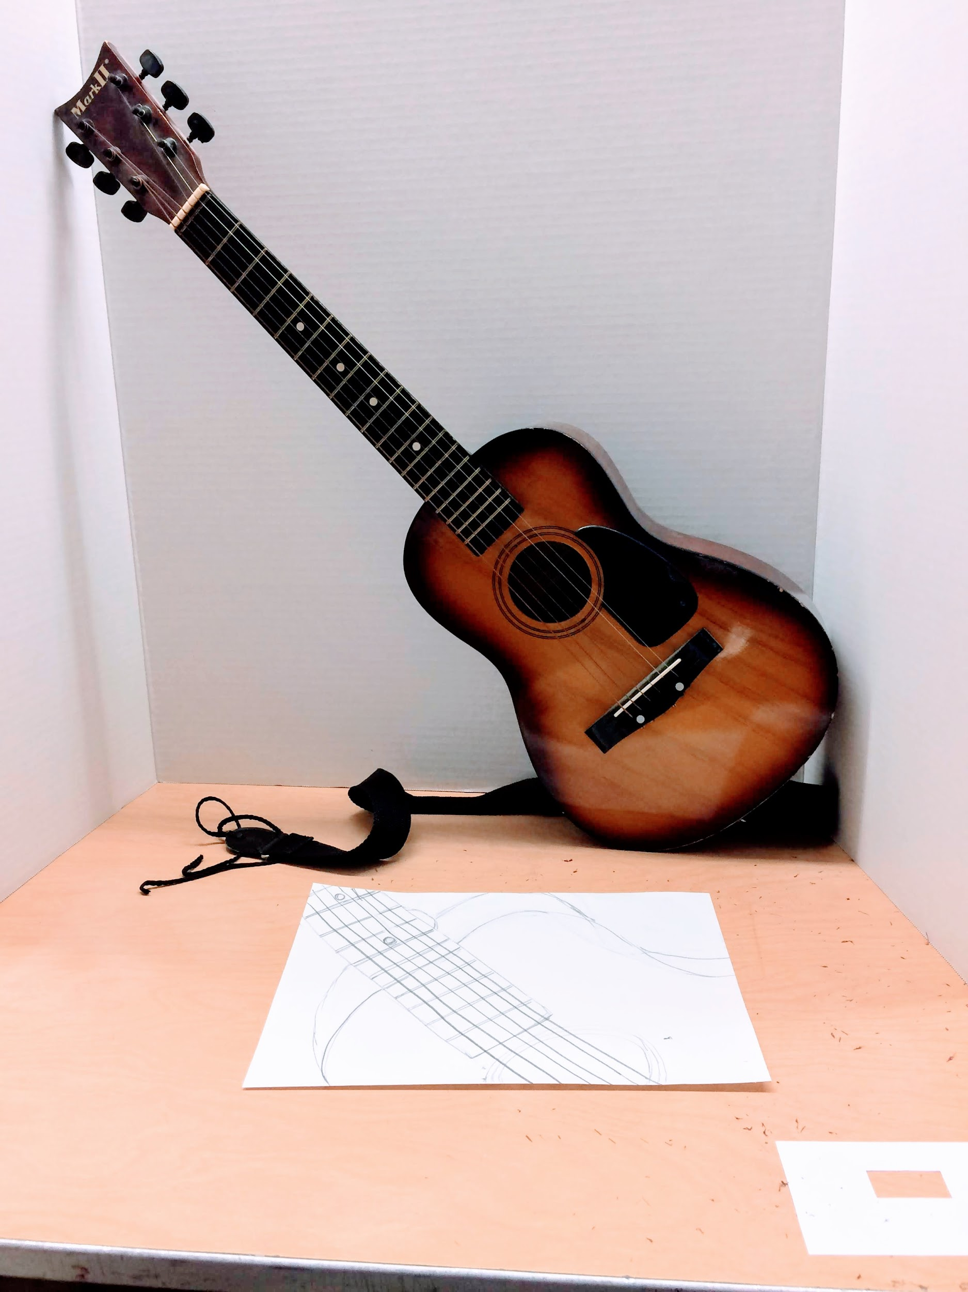
If you don’t have an actual instrument to observe, you can use a photograph or an image from the internet instead. You can even use your viewfinder on the photo to crop the image.

Slide 16
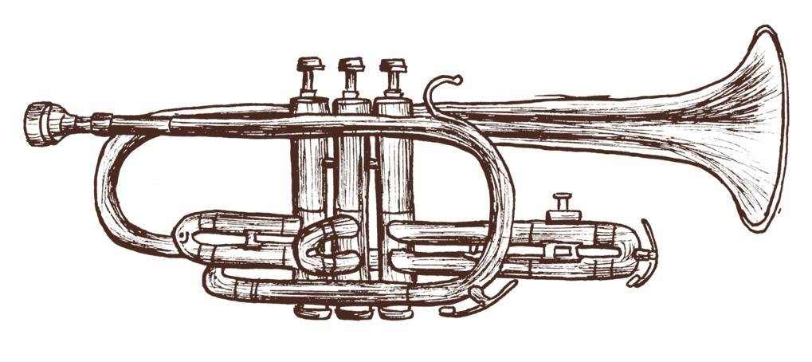
Share your still life!
Email a photo or scan of your still life to Austin Opera- derck@austinopera.org.
Share on TWITTER @AustinOperaEd
Now it’s your turn to create a musical instrument still life. Arrange and observe your objects -- and then begin sketching. Have fun!

