Slide 1
WHAT IS OPERA, ANYWAY?
Including pictures from the book
Bravo! Brava! A Night at the Opera

Slide 2
Where can you …

Slide 7
DRAMA

Slide 8
COMEDY

Slide 9
FANTASY

Slide 10
LOVE

Slide 11
TRAGEDY

Slide 12
COMPOSER & LIBRETTIST

Slide 13
CHARACTERS

Slide 14
BASS

Slide 15
BARITONE

Slide 16
TENOR

Slide 17
COUNTER TENOR

Slide 18
ALTO

Slide 19
MEZZO-SOPRANO

Slide 20
SOPRANO

Slide 21
ORCHESTRA

Slide 22
CHORUS

Slide 23
SUPERNUMERARIES

Slide 24
DANCERS

Slide 25
BACKSTAGE
STAGEHANDS
STAGE
MANAGER

Slide 26
PROPS

Slide 27
MAKE-UP & WIGS

Slide 28
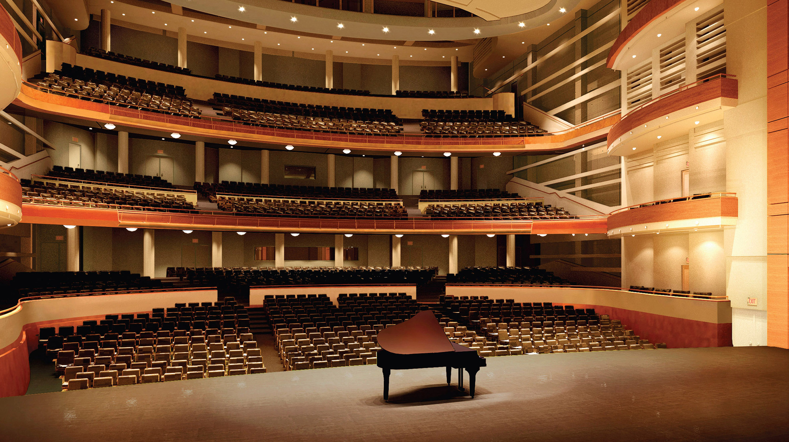
WHAT OPERA JOB WOULD YOU LIKE TO DO?

